Slide 1
Payroll Calculation
SQL Script

Slide 2
Objective:
The database design helps to retrieve the employees’ details based on certain criteria which are listed below.

Slide 3
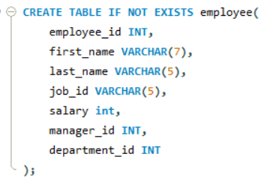
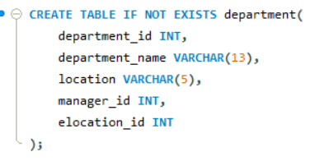
Write a query to create an employee table and a department table.

Slide 4
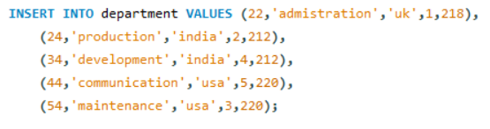
Write a query to insert values in the employee and department tables.

Slide 5
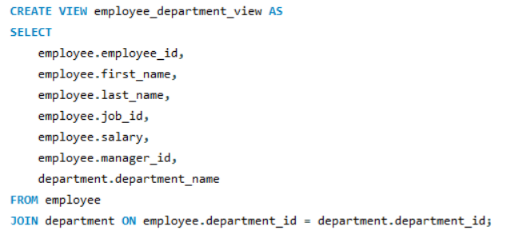
Write a query to create a view of the employee and department tables.

Slide 6
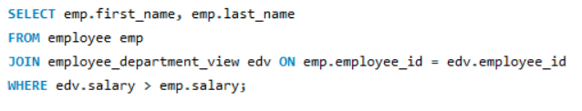
Write a query to display first name and last name of the employees from the employee table and an SQL basics view table if the employee’s salary in the SQL basics table is greater than the salary in the employee table.

Slide 7
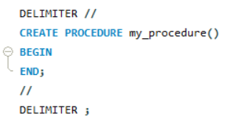
Write a query to change the delimiter to //.

Slide 8
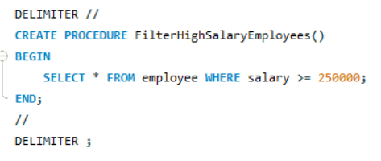
Write a query to create a stored procedure using an employee table if the salary is greater than or equal to 250000.

Slide 9

Write a query to execute the stored procedure.

Slide 10
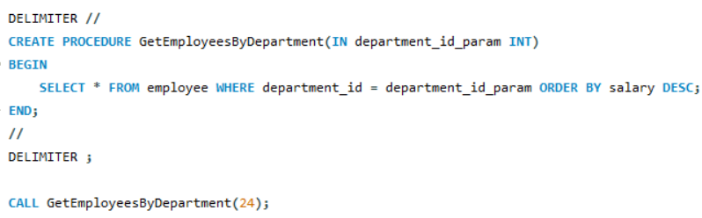
Write a query to create a stored procedure with one parameter using ORDER BY salary in descending order, and execute the stored procedure.

Slide 11
THANK YOU

